Slide 1
Investigation of Cholesterol and Heart Disease Micro-Project 3 https://github.com/Phage13/ANA-500_Aug-25
Ryan Neighbor
20Aug2025

Slide 2
Problem Statement
Despite cholesterol being widely regarded as a key indicator of cardiovascular health in the United States, international standards such as those in Europe define higher thresholds for what is considered cholesterol where medicinal intervention is needed (e.g., >230 mg/dL vs. >200 mg/dL). This discrepancy raises questions about the true predictive value of total serum cholesterol in assessing heart disease risk. The goal of this study is to evaluate whether total cholesterol is a reliable predictor of heart disease when controlling for other biometric indicators, and to compare its predictive strength against other variables such as age, fasting blood sugar (FastingBS), maximum heart rate achieved (MaxHR), and ST-segment depression (Oldpeak).
Notes:
Problem statement – state the occurrence or phenomena that you are attempting describe using data science

Slide 3
Hypothesis Formulation
H₁:
Biometric measures - specifically age, fasting blood sugar (FastingBS), maximum heart rate achieved (MaxHR), and ST-segment depression (Oldpeak) — provide stronger and more reliable predictions of future heart disease risk than serum cholesterol levels alone, when controlling for other relevant health indicators.
H₀:
Serum cholesterol levels are equally or more predictive of future heart disease risk compared to biometric measures such as age, FastingBS, MaxHR, and Oldpeak, when controlling for other relevant health indicators.
Notes:
Hypothesis formulation – a suggested explanation to the problem statement

Slide 4
Acquire
The data set used was a heart disease csv table acquired and transferred into .xlsx
Variables in the data included: Age, Sex, ChestPainType, RestingBP, Cholesterol, FastingBS, RestingECG, MaxHR, ExerciseAngina, Oldpeak, ST_Slope, HeartDisease
Data included Categorical and Numerical values
All Variables exhibited N=918
Categorical Values included Sex, Chest Pain Type, RestingECG, ExerciseAngina, ST_Slope
Numerical Data Included Age, Cholesterol, MaxHR, FastingBS, and Oldpeak
Summary Statistics were found for Numerical Data

Slide 5
Acquire (Interpretation)
AGE
Mean age is approximately 53.5 years, with a range from 28 to 77.
The standard deviation of 9.43 suggests moderate variability, and the age distribution appears slightly skewed toward middle-aged and older adults which is consistent with other studies.
CHOLESTEROL
Mean cholesterol level is 198.8 mg/dL, only slightly below the U.S. threshold of 200 mg/dL for "high" cholesterol. Standard deviation on the other hand is large (109.38), and values range from 0 to 603 mg/dL, indicating potential outliers or data entry issues (e.g., 0 cholesterol is physiologically implausible).
Median cholesterol is 223 mg/dL, which exceeds the U.S. threshold and aligns more closely with European standards this suggests that many individuals in this sample would be classified as high-risk in the U.S.
MaxHR (Maximum Heart Rate Achieved)
Mean MaxHR is 136.8 bpm, with a range from 60 to 202 bpm. The distribution is somewhat wide (std = 25.46), reflecting diverse cardiovascular fitness levels. This variable is especially relevant for stress testing and may correlate strongly with heart disease outcomes.

Slide 6
Acquire (Interpretation)
FastingBS (Fasting Blood Sugar)
This is a binary variable (0 or 1), with a mean of 0.233, indicating that roughly 23.3% of patients had elevated fasting blood sugar (>120 mg/dL). As there are known linkages between diabetes and cardiovascular risk, this variable could be an important control variable.
Oldpeak (ST-Segment Depression)
Mean Oldpeak is 0.89, with a range from -2.6 to 6.2.
Negative values may reflect measurement artifacts or atypical ECG readings.
The standard deviation of 1.07 and a median of 0.6 suggest a right-skewed distribution, with some patients showing significant ST depression — a known marker of ischemia.

Slide 7
Prepare
Summary Statistics for Numerical Data
Value Names and group counts for Categorical Data
Initial correlation heatmap procured
Created Normalized Values & added to data frame
New correlation heatmap was observed
Values above 0.2 or below -0.2 were considered promising when comparing to heart disease (1 or -1 is perfect correlation)
Age Groups were binned into 4 equal groups from 0-100, and compared Cholesterol for mean, max, min, and n within respective groups.

Slide 8
Prepare (Interpretation)
Cholesterol shows high variability and potential outliers, which may weaken its predictive power unless normalized or transformed.
Age, MaxHR, FastingBS, and Oldpeak all show meaningful variation and clinical relevance, this may yield outperform results of those variables to Cholesterol in predicting heart disease.
Due to the data sets clean data structure and complete records - logistic regression, decision trees, or ensemble models like random forests are preferable techniques to use once 0 Cholesterol variable values are removed or averaged based on all other Cholesterol values.
Notably, when binning AGE groups 76-100 Years of AGE only had 4 observations of participants.

Slide 9
Prepare (Interpretation)
After the data is cleaned (0 Cholesterol Values Removed), normalized, and correlated:
The correlation between Cholesterol and Heart Disease is now r = 0.10, a very weak positive relationship that suggests higher cholesterol levels are not reliably associated with increased cardiac risk in this dataset.
Oldpeak (measuring ST-segment depression during exercise) shows the strongest positive correlation with Heart Disease at r = 0.50, indicating that exercise-induced cardiac stress is a driving predictor.
MaxHR (maximum heart rate achieved) has a strong negative correlation of r = -0.38, reinforcing that cardiovascular performance during exertion is closely tied to Heart Disease presence.
Age correlates with Heart Disease at r = 0.30, and Fasting Blood Sugar (FastingBS) at r = 0.16. Age exhibits moderate positive relationships and outperforms Cholesterol while FastingBS is weaker. Both outperform Cholesterol.
Oldpeak’s correlation with Age (r = 0.29) and MaxHR’s correlation with Age (r = -0.38) suggest that age-related decline in cardiac function plays a significant role.
RestingBP shows only a weak correlation with Heart Disease (r = 0.17).
Findings: Oldpeak and MaxHR are more reliable indicators of Heart Disease than Cholesterol while those same driving variables seem to have correlations to Age.

Slide 10
Analyze data
Histograms
Box Plots
Scatterplot w/ trendlines
Bubble Plot w/ HeartDisease Color Coding
Normalized Scatterplot

Slide 11
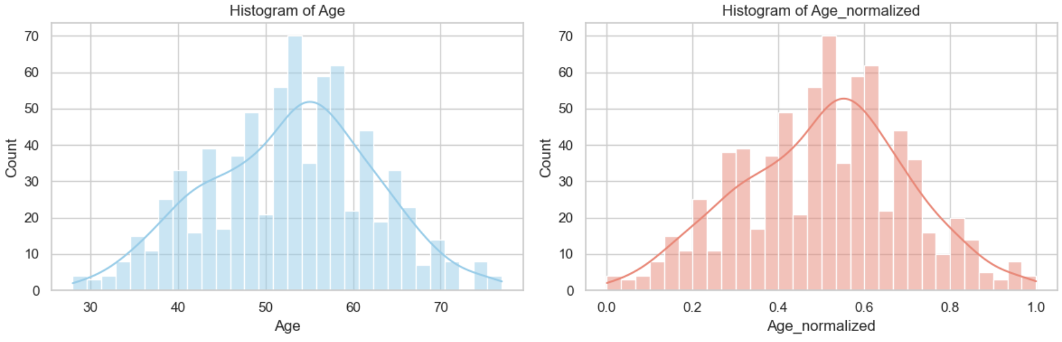
Analyze/Report Data – Age Histogram
Age represents the patient's age in years and is a common demographic and clinical variable in cardiovascular risk assessment. Risk typically increases with age due to cumulative exposure to metabolic and vascular stressors.
The histograms show a slightly left-skewed distribution, with most patients clustered between 45 and 60 years old. The normalized version preserves this shape, scaled between 0 and 1 for modeling purposes. This distribution suggests a mid-to-late adult cohort at around 55 YO peak, exhibiting slightly ununiform distribution.

Slide 12
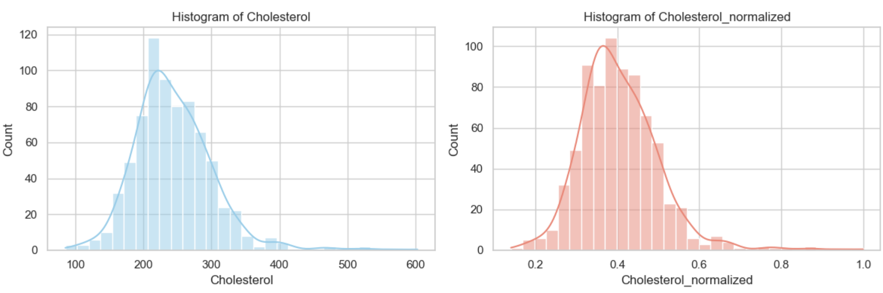
Analyze/Report Data – Cholesterol Histogram
Cholesterol measures the total serum cholesterol level (mg/dL) and are a common biomarker for cardiovascular risk.
The histograms show a right-skewed distribution, with most values between 150–300 mg/dL. The normalized version maintains this skew, scaled between 0 and 1, with most data concentrated around 0.2–0.6. This shape suggests that while high cholesterol is present in a subset of patients, it’s not uniformly distributed and may require stratification or interaction analysis to assess its true predictive impact.

Slide 13
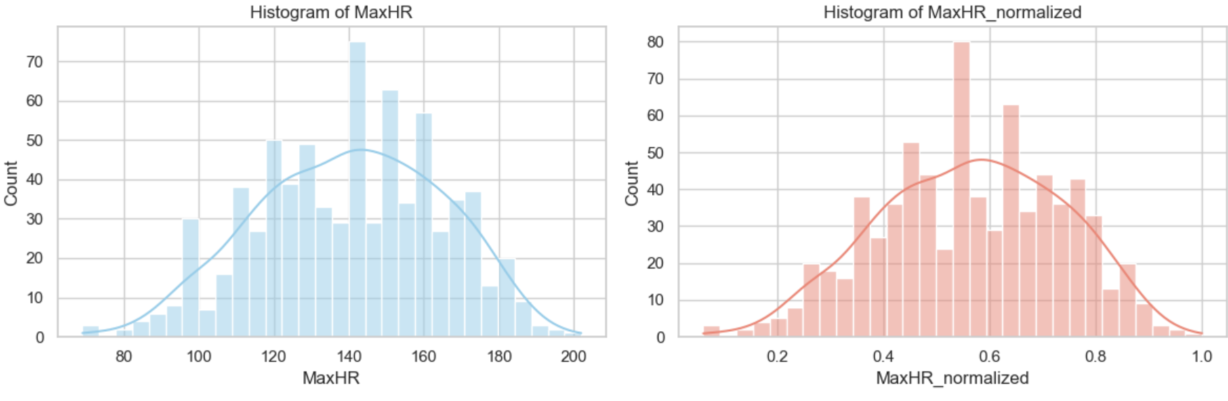
Analyze/Report Data – MaxHR Histogram
MaxHR represents the maximum heart rate achieved during exercise, typically measured in beats per minute (bpm). It reflects cardiovascular fitness and stress response, with lower values potentially indicating reduced cardiac function or chronotropic incompetence.
The histograms show a roughly normal distribution, centered around typical adult exercise heart rates (~150 bpm), tapering off toward both lower and higher extremes. The normalized version retains this bell-shaped curve, scaled between 0 and 1 for algorithmic consistency. This symmetric pattern suggests MaxHR supports the central limit theorem for modeling, with potential predictive value depending on age-adjusted expectations or disease presence.

Slide 14
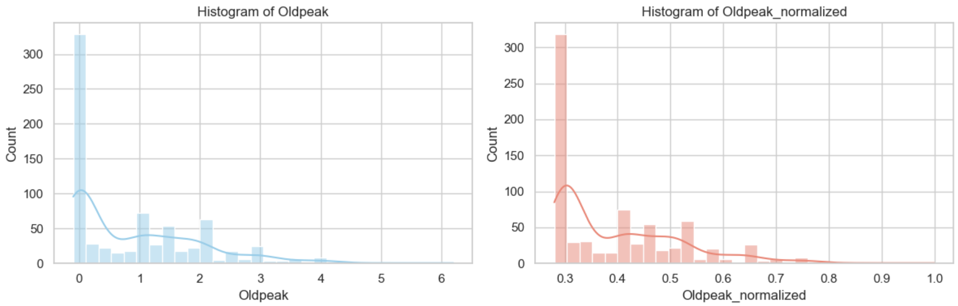
Analyze/Report Data – Oldpeak Histogram
Oldpeak quantifies ST segment depression (in mm) during exercise which is used to indicate potential myocardial ischemia. Higher values suggest reduced cardiac perfusion and are associated with increased heart disease risk.
The histograms show a right-skewed distribution: Most patients have low Oldpeak values near zero, with a sharp decline as values increase. The normalized version preserves this shape and is scaled between 0 and 1 for model compatibility. This long-tailed pattern suggests that elevated Oldpeak values even in low quantity may carry significant predictive weight in cardiovascular risk models.

Slide 15
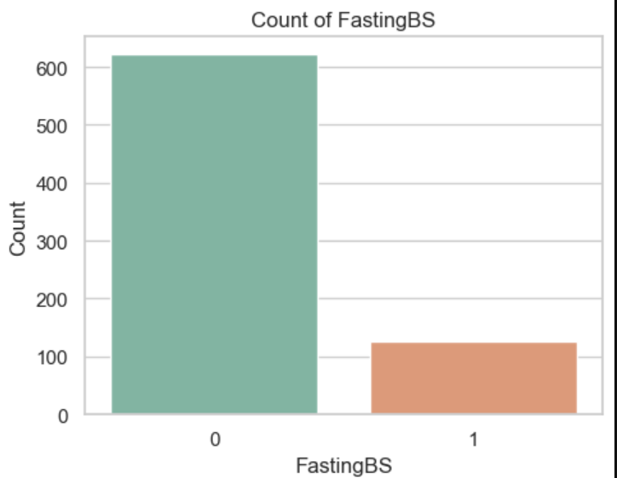
Analyze/Report Data – Fasting BS
FastingBS is a binary indicator of fasting blood sugar levels:
0 = ≤120 mg/dL (normal)
1 = >120 mg/dL (elevated)
The bar chart shows a highly imbalanced distribution, with most patients falling in the normal range (FastingBS = 0). Elevated fasting blood sugar (FastingBS = 1) is relatively rare, suggesting limited prevalence of hyperglycemia in this cohort. This imbalance may affect model sensitivity and should be considered when evaluating glucose-related risk factors.

Slide 16
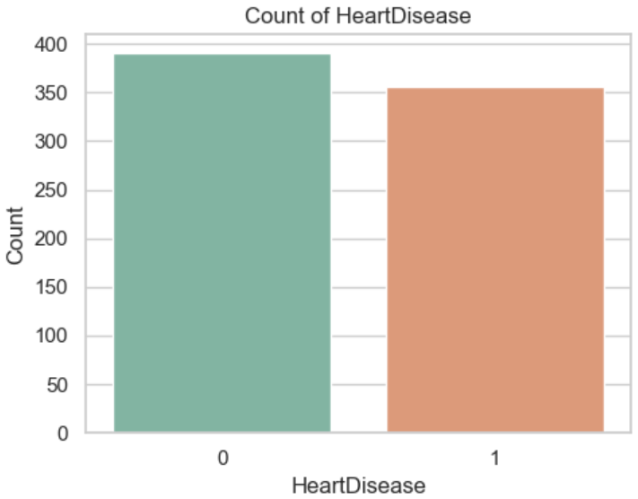
Analyze/Report Data – HeartDisease
HeartDisease is a binary outcome variable:
0 = no heart disease
1 = presence of heart disease
The bar chart shows a slightly imbalanced distribution, with more individuals in the non-disease group. This suggests a modest class imbalance and could affect classification tasks in modeling. This split should be accounted for in evaluation metrics and sampling strategies.

Slide 17
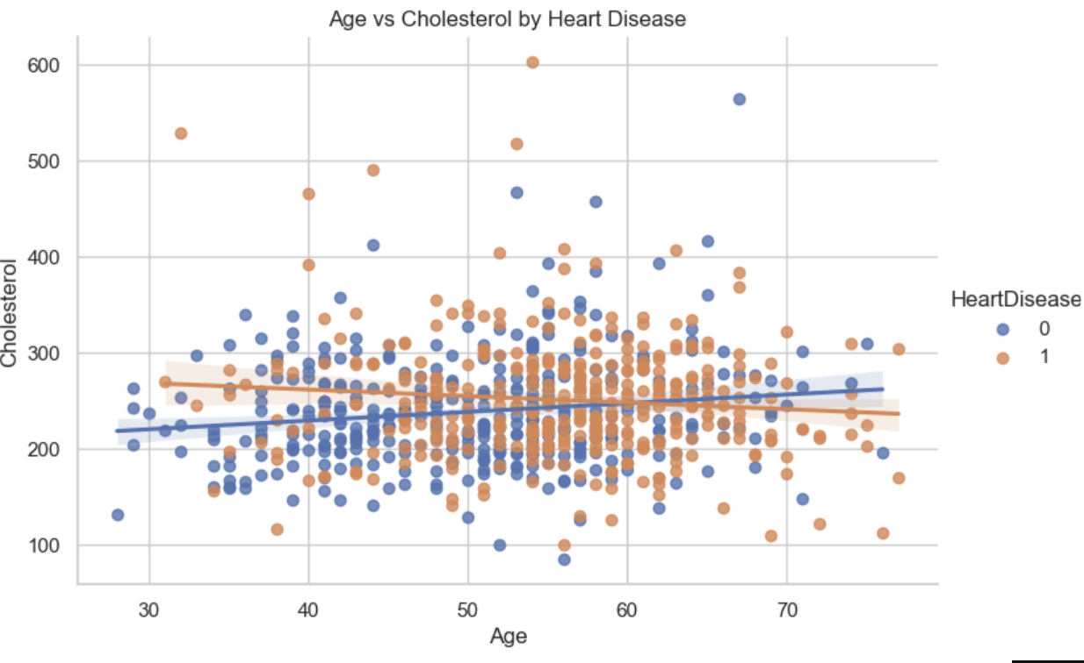
Analyze/Report Data – Cholesterol vs. Heart Disease
This scatter plot shows the relationship between Age and Cholesterol and is stratified by HeartDisease status. Blue points represent individuals without heart disease, while orange points represent those with it. Both groups show wide variability in cholesterol across ages. There is no strong visual separation between disease and non-disease groups.
The trend lines for each group are relatively flat, suggesting weak or no linear correlation between age and cholesterol irrespective of heart disease status. This supports the idea that cholesterol alone may not be a strong age-dependent predictor of heart disease suggesting a need to consider other biometric factors in risk modeling.

Slide 18
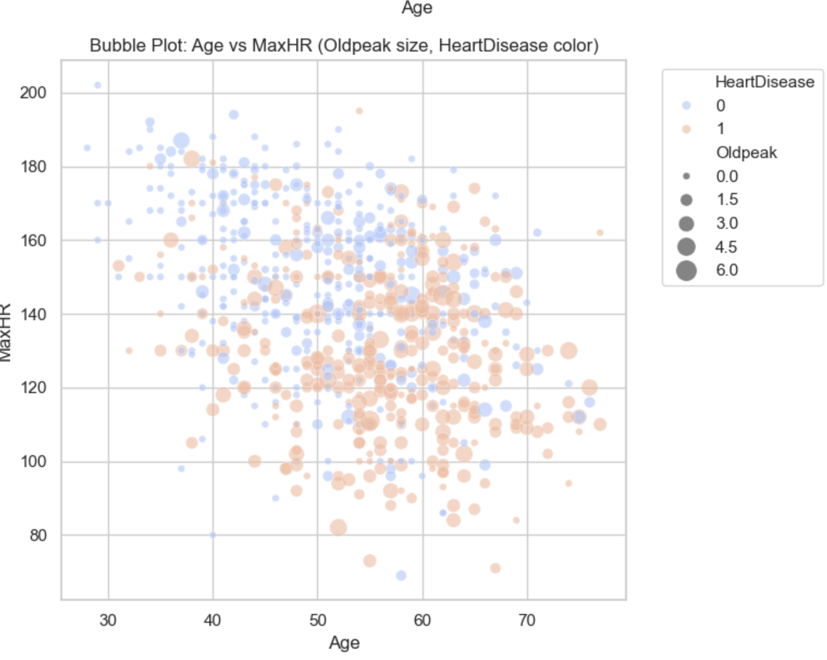
Analyze/Report Data – Age vs MaxHR
This bubble plot visualizes the relationship between Age and MaxHR (maximum heart rate), with two additional dimensions:
•Bubble size reflects Oldpeak (ST depression induced by exercise),
•Bubble color indicates HeartDisease status (blue = no heart disease, orange = heart disease).
From the plot, we observe that individuals with heart disease (orange bubbles) tend to cluster at lower MaxHR values, especially in older age groups. Larger bubbles (indicating higher Oldpeak) are more frequently associated with heart disease, suggesting that elevated Oldpeak and reduced MaxHR may be linked to cardiac risk.

Slide 19
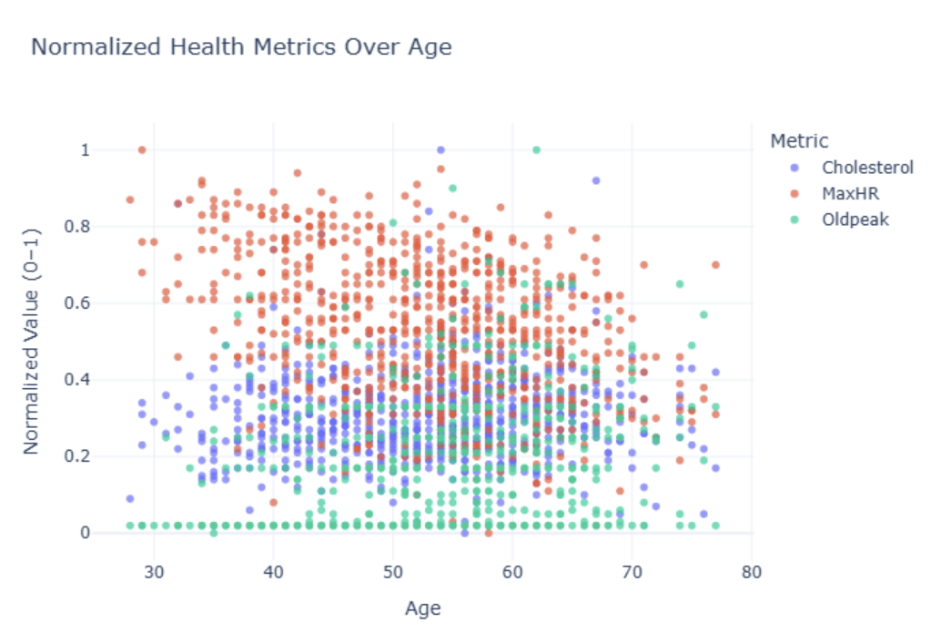
Analyze/Report Data – Age vs Normalized Biometrics
This scatter plot illustrates how normalized health metrics Cholesterol (blue), MaxHR (red), and Oldpeak (green) vary across age.
MaxHR values decline steadily with age, reflecting reduced cardiovascular capacity.
Oldpeak shows greater variability, with elevated levels more common in older individuals, suggesting increased exercise-induced stress.
Cholesterol appears more evenly distributed, with modest clustering in mid-to-late age ranges.
This chart suggests that age-related shifts in MaxHR and Oldpeak may offer stronger signals of cardiac risk than cholesterol alone.

Slide 20
Analyze/ Report – Logistic Regression Model
HeartDisease = 1 / (1 + e^-(0.6687 × Cholesterol_normalized - 3.1501 × MaxHR_normalized + 4.6872 × Oldpeak_normalized + β₀))
The model accuracy = 77%
AUC-ROC = 0.85, meaning strong classification performance.
Precision is 0.83 for heart disease (class 1) and 0.71 for non-heart disease (class 0)
Recall is 0.70 for class 1 and 0.85 for class 0.
F1-scores are balanced at 0.76 and 0.77, respectively.
Predictor Interpretation:
Oldpeak_normalized has the strongest effect with a coefficient of 4.69 and an odds ratio of 108.55, indicating a substantial increase in heart disease risk.
MaxHR_normalized has a coefficient of –3.15 and an odds ratio of 0.04, showing a strong protective effect.
Cholesterol_normalized has a moderate positive association with heart disease, with a coefficient of 0.67 and an odds ratio of 1.95.

Slide 21
Act
<apply results, connect results with the chosen problem statement or business question>

